Slide 1

US Road Accident Intelligence & Risk Prediction System
A data-driven web platform analyzing 15 years of US traffic accident data to identify high-risk locations, time patterns, and victim demographics, providing predictive insights and interactive dashboards for road safety planning.
By:
P.V.S Sruthi
23BDS0176
Notes:
1

Slide 2





PROJECT OVERVIEW
Building a Comprehensive Decision-Support System
This project transcends mere analysis by developing three integrated components that form a robust decision-support system for road safety.
R-based Data Science Engine
Power BI Analytics Dashboard
Cleans, analyzes, and models extensive accident data for accurate insights.
Provides interactive visual insights tailored for policymakers and the public.
Website Interface
Hosts dashboards, explains key insights, and presents predictive outcomes.
Notes:
2

Slide 3
REAL-WORLD IMPACT
Addressing Critical Road Safety Challenges
Our project directly tackles significant real-world problems in road safety, providing actionable solutions for various stakeholders.
Accident Hotspot Detection
Temporal Trend Analysis
Leverages geo and area analysis to identify locations with high accident clusters, guiding resource allocation.
Analyzes accident variations by hour, day, and season to uncover dangerous time patterns.
Vulnerable Group Identification
Predictive Risk Modelling
Examines victim demographics (age, sex, descent) to pinpoint and protect at-risk populations.
Offers data-driven planning capabilities by forecasting accident risks for proactive interventions.
This makes the project highly relevant for traffic police, urban planners, insurance firms, and public safety departments.
Notes:
3

Slide 4

MODULE 1: DATA PREPROCESSING
Foundation of Insight: Data Understanding & Preprocessing (R)
Key Tasks Involved
R Concepts Applied
Efficiently load large CSV files (~6+ lakh rows).
data.table, dplyr, lubridate, stringr for data manipulation.
Implement robust handling for missing values.
Advanced feature engineering techniques.
Accurately convert and extract date & time components (Year, Month, Day, Hour buckets).
Memory-efficient handling strategies for large datasets.
Clean and standardize victim demographic data.
Convert location data into precise Latitude & Longitude coordinates.
This module is crucial for robust analysis and accounts for significant marks due to large-scale data handling and complex preprocessing logic.
Notes:
4

Slide 5





MODULE 2: EXPLORATORY DATA ANALYSIS (EDA)
Uncovering Patterns: Insight-Driven Storytelling
Exploratory Data Analysis goes beyond simple plots to reveal critical insights into accident trends and characteristics.
Temporal Trends
Geographic Distribution
Time-of-Day Risks
How have accidents evolved from 2010 to 2025?
Which areas experience the highest collision frequencies?
Identifying the most dangerous periods throughout the day.
Victim Demographics
Premise Type Analysis
Understanding the age groups and genders most affected.
Assessing risks associated with different premise types (street, parking, etc.).
Notes:
5

Slide 6


MODULE 3: SPATIAL ANALYSIS
Pinpointing Risk: Spatial & Hotspot Analysis
Utilizing precise geographic data to identify and prioritize high-risk zones, mirroring real-world city planning tools.
Core Activities
Techniques Employed
Identification of accident hotspots.
Density-based grouping algorithms.
Clustering of high-risk zones for targeted interventions.
Calculation of accident counts per square region.
Ranking areas based on accident severity and frequency.
Using MO codes as a proxy for accident severity.
This high-value module demonstrates practical application in urban planning and emergency services.
Notes:
6

Slide 7
MODULE 4: PREDICTIVE MODELING
Beyond Analysis: Advanced Predictive Modeling (R)
Elevating the project from good to excellent with robust predictive analytics for proactive safety measures.
Prediction Goals
Key Features
Models Utilised
Evaluation Metrics
Accident Risk Level: Classifying locations and times into Low, Medium, or High-risk categories.
Area ID, Hour, Day, Month, Premise Code, Victim Age Group.
Logistic Regression (baseline for comparison).
Accuracy, Confusion Matrix, and Feature Importance to validate model performance.
Incorporation of historical accident frequency data.
Random Forest for enhanced accuracy and feature importance.
Expected Accident Count: Forecasting the number of accidents for specific area and time combinations.
Decision Tree for interpretability.
Notes:
7

Slide 8
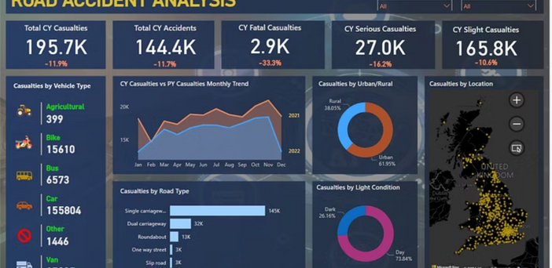
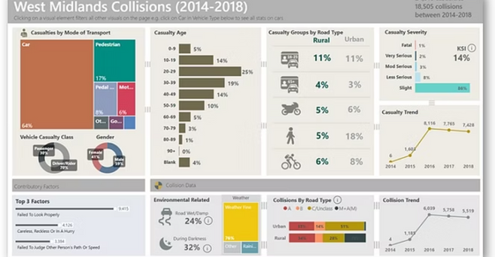
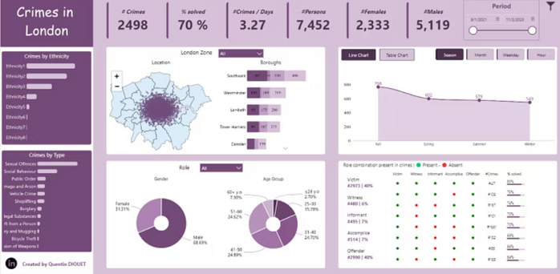
MODULE 5: POWER BI DASHBOARD
Interactive Insights: Professional-Grade Visualization
The Power BI Dashboard provides intuitive and interactive visualizations for an engaging user experience, crucial for policymakers and the public.
1
Comprehensive Pages
2
Dynamic Filters
3
Visual Storytelling
Overview, Time Analysis, Location Intelligence, Victim Demographics, and Prediction Insights.
Enables users to filter data by year, area, and other key parameters.
Trend lines, heatmaps, and geographic drill-downs for deep insights.
Notes:
8

Slide 9












WEBSITE INTERFACE
The Presentation Layer: Engaging & Informative
The website serves as the central hub for presenting the project's findings, methodology, and utility in a structured and accessible manner.
Home Page
Dashboard Page
Project title, problem statement, dataset overview, and real-world relevance.
Embedded Power BI reports with user-friendly navigation and visible filters.
Future Scope Page
Insights Page
Discussion on real-time data integration, police & insurance usage, and smart city integration.
Key findings presented with text and chart screenshots, detailing "What we discovered."
Methodology Page
Prediction Page
Detailed steps for data cleaning, algorithms used, and technology stack.
Explanation of prediction logic, sample outputs, and risk category definitions.
Notes:
9

Slide 10

FUTURE VISION
Expanding Horizons: Future Scope & Real-World Utility
The project's potential extends beyond its current scope, offering numerous avenues for future development and broader impact.
Key Future Enhancements
Impactful Applications
Real-time accident data ingestion for immediate updates.
Traffic Police: Optimized patrol allocations and proactive accident prevention.
Weather-based risk prediction to enhance accuracy.
Urban Planners: Informed road design improvements and infrastructure development.
Mobile application development for public alerts and safety.
Seamless integration with Google Maps for navigation and warnings.
Emergency Services: Efficient resource deployment and ambulance placement.
AI-driven accident prevention alerts for autonomous systems.
Insurance Companies: Refined risk-based premium calculations.
Notes:
10

